Slide 1
Learning Graph Database – Neo4j, Cypher, & GraphGist

Slide 2
Outline
Objectives and Intents
Graph Database
Modeling
Cypher Query Language
GraphGist

Slide 3
Objectives
How to describe our problem in graph and how to search the solution?
Using Neo4j Cypher and GraphGist as a learning tools, example: Partial San Francisco Bay Map.

Slide 4
Modeling Workflow
Goal
Problem Space
Scenarios and Questions
Graph Database
Use Cases and Queries
Conclusion and Future Works

Slide 5
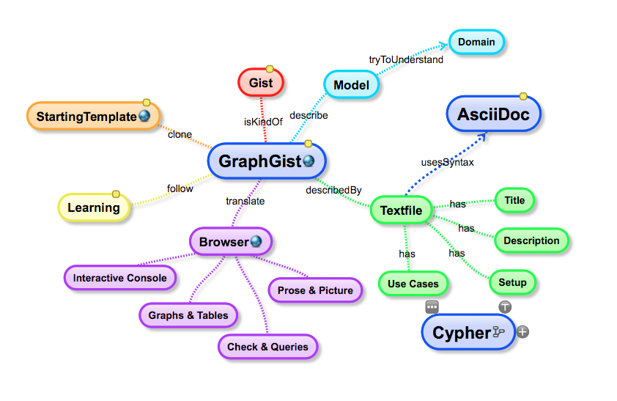
Model with GraphGist

Slide 6
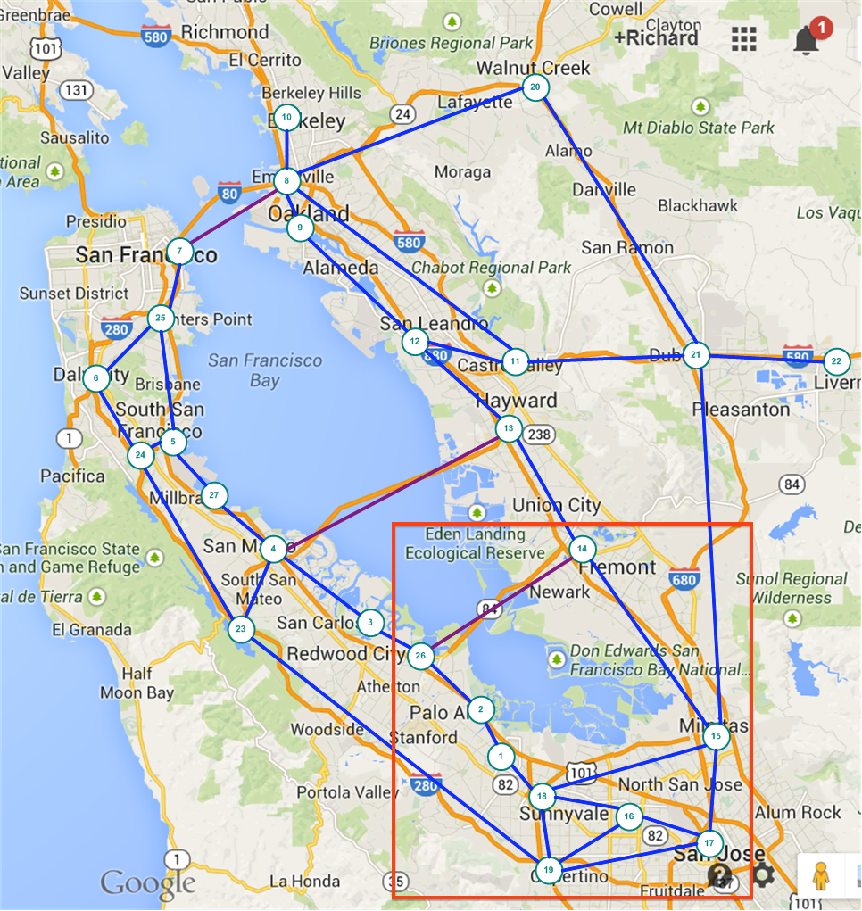
Using San Francisco Road Map to Understand Some Concepts of Social Networking and Graph Database

Slide 7
Objects in Domain
Cities
name, population
population growth, incoming workers, out coming workers
has major facilities (school, airport, sport stadium,..)
Roads connect Cities
name, distance (length)

Slide 8
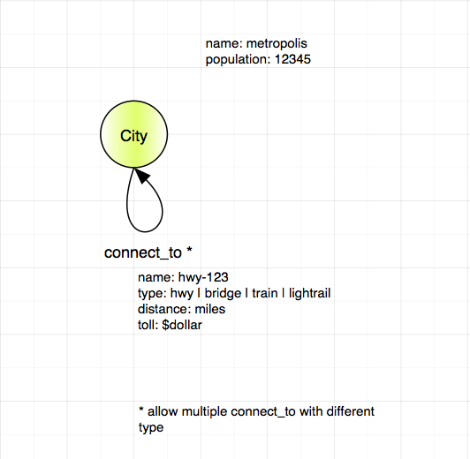
Model – version 0.1 - Simple

Slide 9
Cypher Statement – 1 for more details see https://github.com/rkuo/GraphGist/blob/master/sfbaymap/notes%20for%20neo4j%20presentation%2020140919.md
Add city.
Add connect_to as relationship between cities.
```
MATCH (a:City {name: 'Mountain View'}),
(b:City {name: 'Palo Alto'})
MERGE (a)-[r:connect_to {distance: 5.5}]->(b)
```
Verify cities are connected with paths.
Inspect the properties: population.
Notes:
Add statement here:

Slide 10
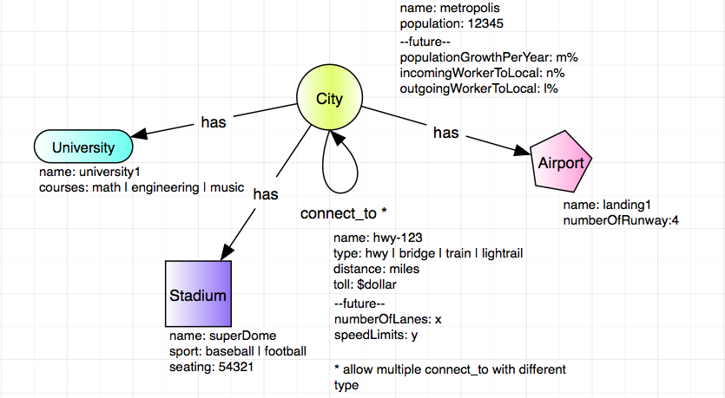
Model – version 0.2 – more Objects

Slide 11
Cypher Statement - 2
Add more objects:
Schools, Airport, Stadium.
```
MATCH (n01: City)
WHERE n01.name = 'Mountain View'
MERGE (s02:School {name: 'Foothill Community College'})
MERGE (n01)-[:has]->(s02)
RETURN
n01, s02
```
Connect them with relationships:
has.
Use the database to answer some questions.

Slide 12
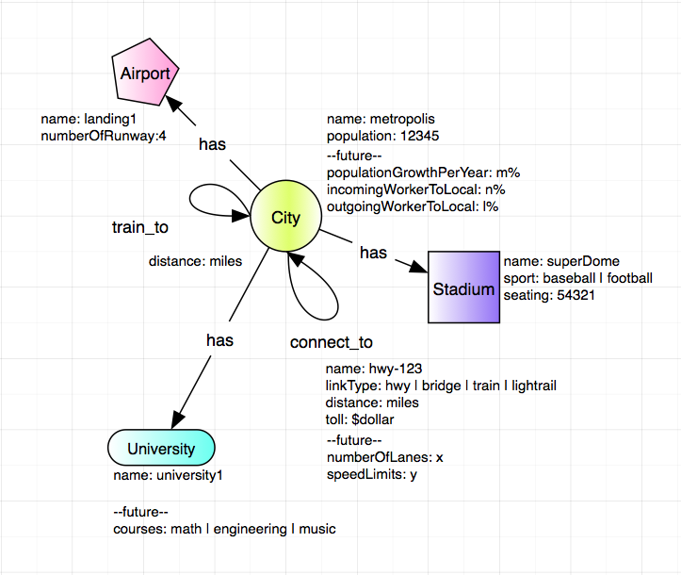
Model – version 0.3 – More Links

Slide 13
Cypher Statement - 3
Add train_to for city to city with property: distance.
```
MATCH (n01:City {name: 'Mountain View'}),
(n02:City {name: 'Palo Alto'})
MERGE (n01)-[:train_to {distance: 5.4}]->(n02) // drop 0.1 mile
MERGE (n02)-[:train_to {distance: 5.4}]->(n01)
```
Find the shortest path between 2 cities.
```
MATCH p = allShortestPaths((s {name: 'Palo Alto'})-[r:connect_to*..5]->(d {name: 'Sunnyvale'}))
RETURN NODES(p)
```
Review algorithms: shortestPath.

Slide 14
Demo
Local ->
~ » cd ~/Tools/neo4j-community-2.1.3
Tools/neo4j-community-2.1.3 » ./bin/neo4j start
Browser ->
localhost:7474
GraphGist Site -> Education: SF bay map

Slide 15
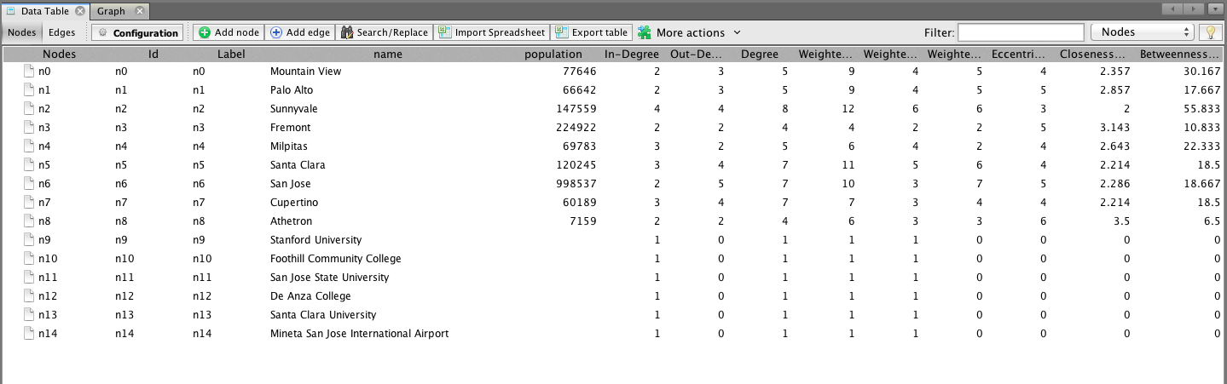
Import & Export to Gephi

Slide 16
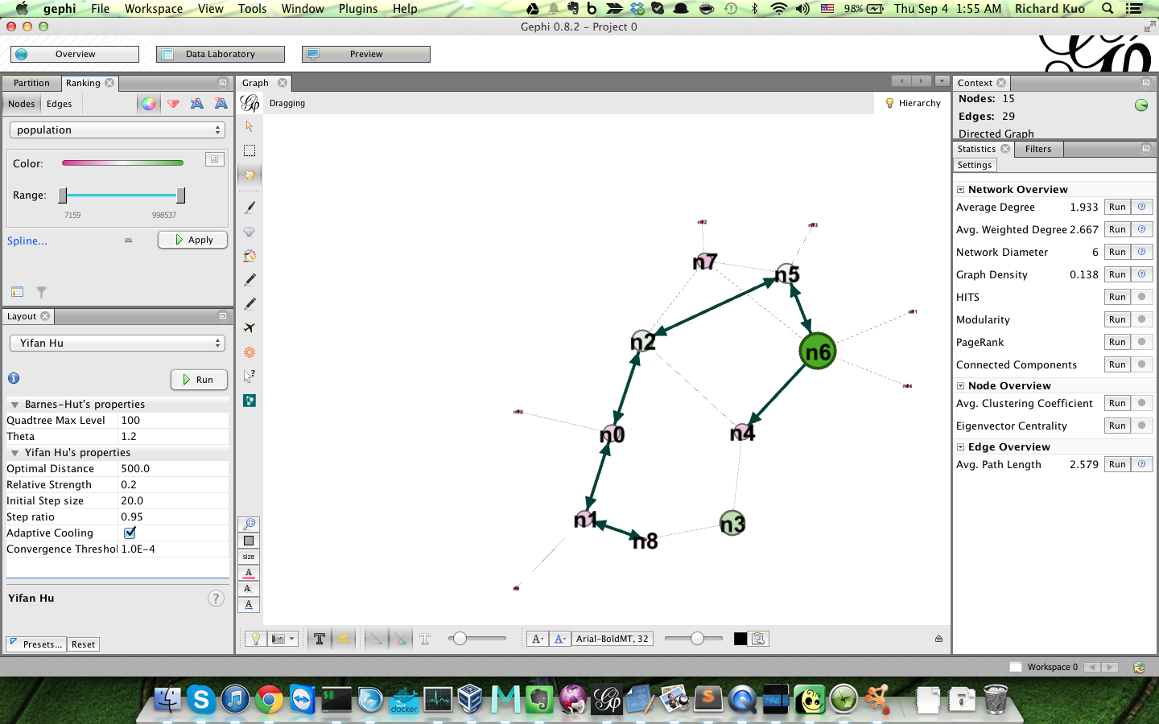
Analysis with Gephi

Slide 17
References
Code, slides and notes at github/rkuo github repo
Graph Theory
[marko](http://glennas.wordpress.com/2011/03/13/understanding-graph-databases-marko-rodriguez/)
Neo4j Community
[community](http://www.neo4j.org/)
Open Data
[village population](http://data.ca.gov/)

Slide 18
Backup Slides

Slide 19

Seven Bridges of Konigsberg (http://en.wikipedia.org/wiki/Seven_Bridges_of_K%C3%B6nigsberg)
Notes:
(http://en.wikipedia.org/wiki/Leonhard_Euler)
Current, Kaliningrad, Russia http://en.wikipedia.org/wiki/Kaliningrad

Slide 20
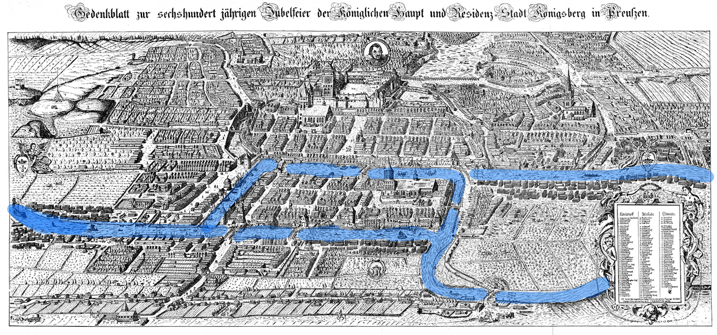






Königsberg (Prussia) - 1736
A
B
C
D
Notes:
Quiz: “Who knows the current name of Königsberg?” - Answer: Kaliningrad.
Euler lived in Königsberg for a while, and in 1736 he created and solved the problem known as the “7 Bridges of Königsberg”. The problem is to decide whether it is possible to follow a path that crosses each bridge exactly once and return to the starting point. This problem was the first study of graph theory.
Königsberg was divided into multiple areas by the Pregel river, and the 7 bridges (animation forward) joined the different city areas together. Euler first identified these 4 land masses (animation forward) and pointed out that the choice of route inside each of the 4 city areas was irrelevant to the problem.
This seems obvious now, but it was a major insight at the time and allowed Euler to reformulate the problem in abstract terms.

Slide 21
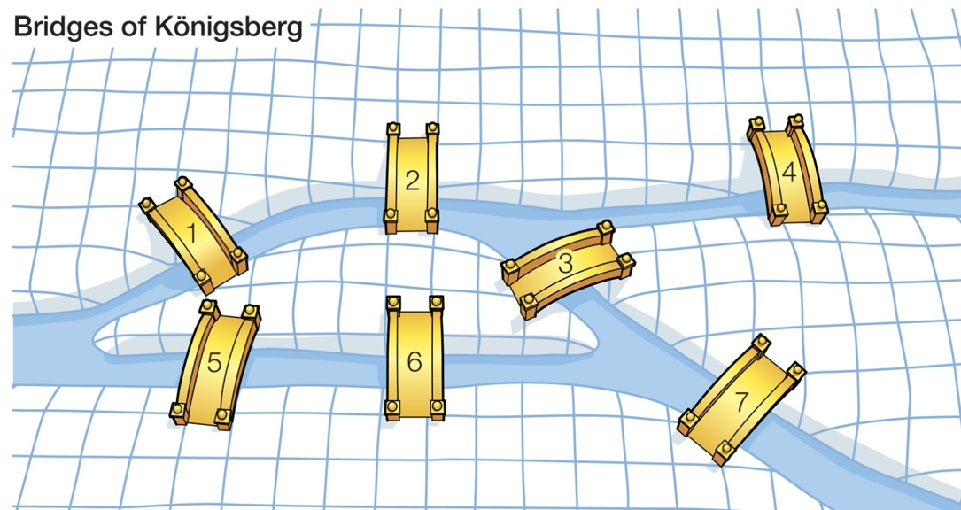
1
A
4
2
B
C
3
6
5
D
7
Notes:
With these two understandings, Euler eliminated all features all features except the list of land masses and the bridges connecting them. In modern terms, one replaces each land mass with an abstract "vertex", and each bridge with an abstract connection, an "edge".
“For normal humans (not mathematicians) we find it easier to use the terms ‘Node’ and ‘Relationship’.”
This resulting structure is called a graph.

Slide 22
What is Graph?
Graph G(V, E)
where
Vertex (node), V = {v1, v2, v3 …}
Edge (link), E = {e1,e2,e3, …}
represented by
- adjacent matrix or
- linked list
- incidence matrix
http://en.wikipedia.org/wiki/Graph_(abstract_data_type)
Directed/undirected
Weighted
Multiple graph: more than one links between two nodes.
Nodes and links can have properties.

Slide 23
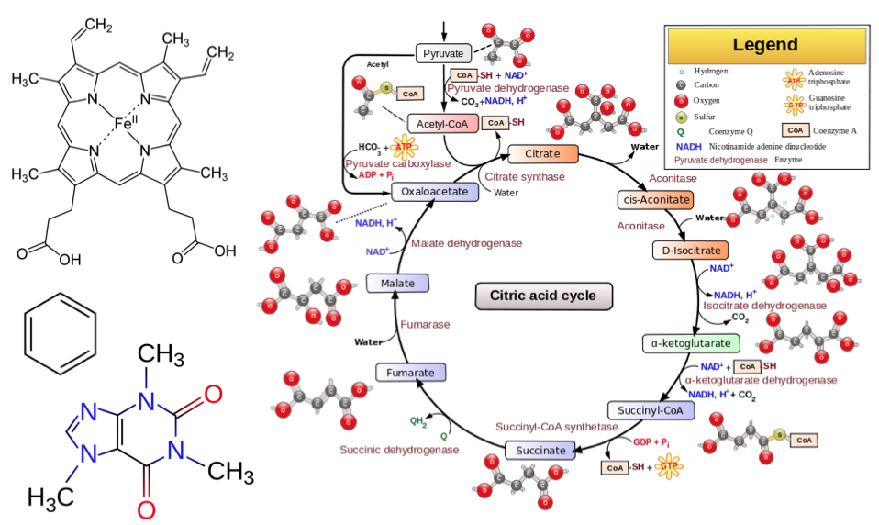
Graph Everywhere: [Bio] Chem (http://www.meetup.com/graphdb-baltimore/events/166931952/)

Slide 24
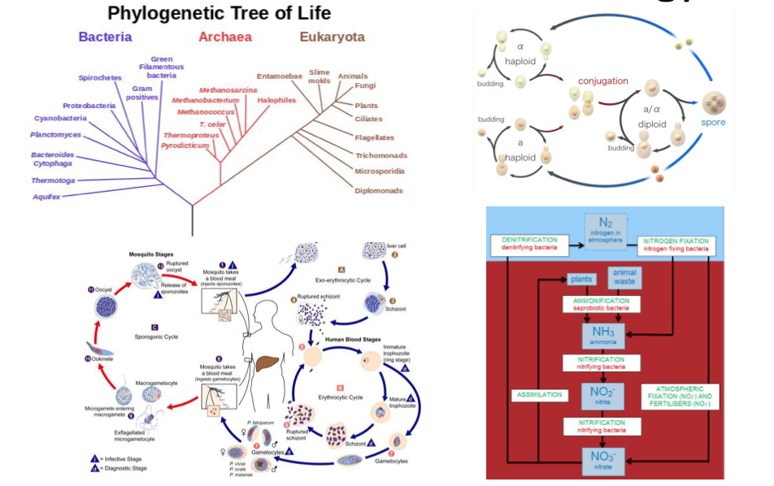
Graph Everywhere: Biology (http://www.meetup.com/graphdb-baltimore/events/166931952/)

Slide 25
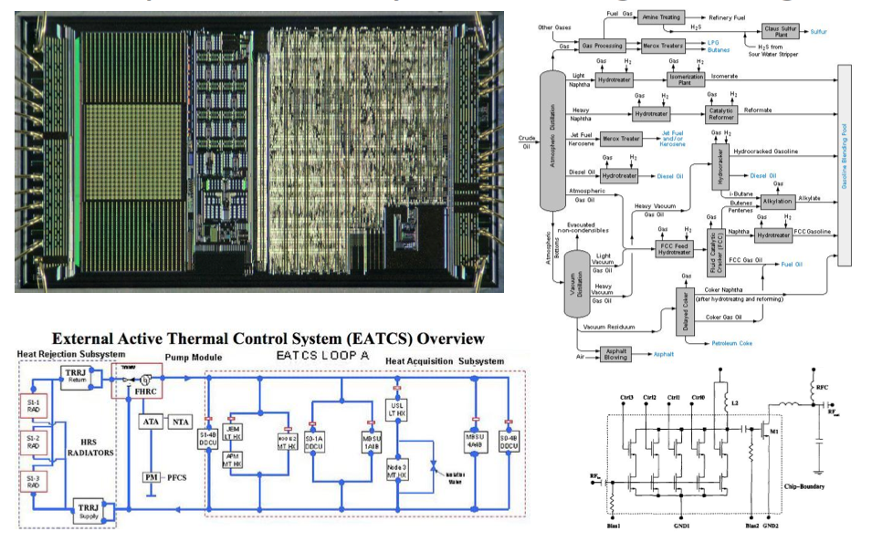
Graph Everywhere: Engineering (http://www.meetup.com/graphdb-baltimore/events/166931952/)

Slide 26
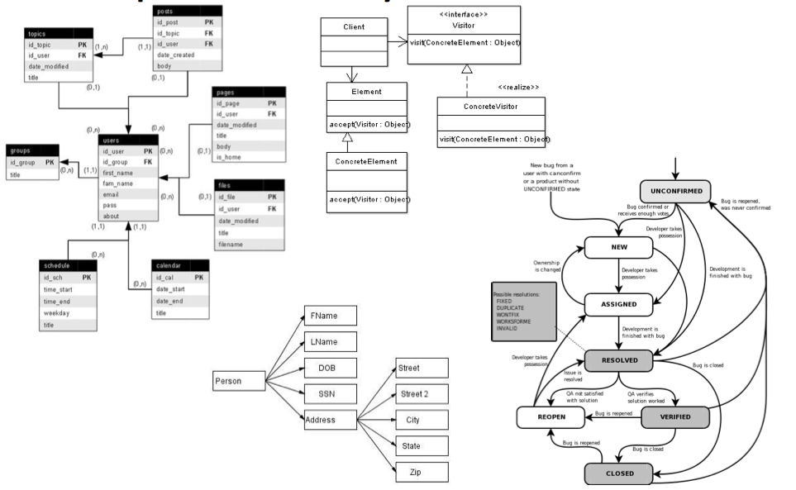
Graph Everywhere: Software (http://www.meetup.com/graphdb-baltimore/events/166931952/)

Slide 27
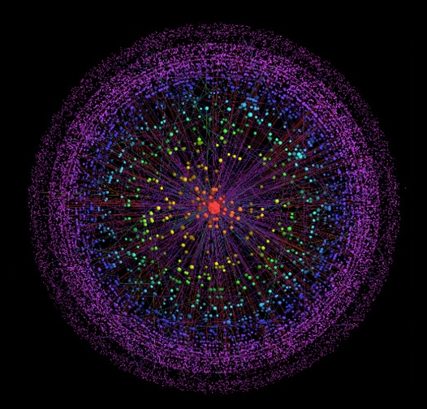
Graph Everywhere – Internet from: http://internetlooks.com/internetandwww.html

Slide 28
Not only SQL (NoSQL) http://en.wikipedia.org/wiki/NoSQL
Key-Value Database
In this model, data is represented as a collection of key-value pairs, such that each possible key appears at most once in the collection.
Column Database
It stores data tables as sections of columns of data rather than as rows of data.
Document Database
In general, they all assume that documents encapsulate and encode data (or information) in some standard formats or encodings. Encodings in use include XML, YAML, and JSON as well as binary forms like BSON, PDF and Microsoft Office documents (MS Word, Excel, and so on).
Graph Database
This kind of database is designed for data whose relations are well represented as a graph (elements interconnected with an undetermined number of relations between them).
etc

Slide 29
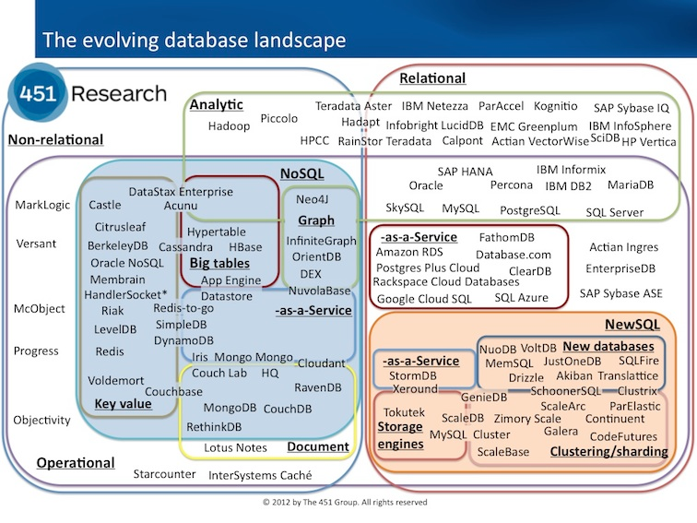
SQL (Structured Query Language) & NoSQL from https://blogs.the451group.com/information_management/files/2012/11/DBlandscape.jpg

Slide 30
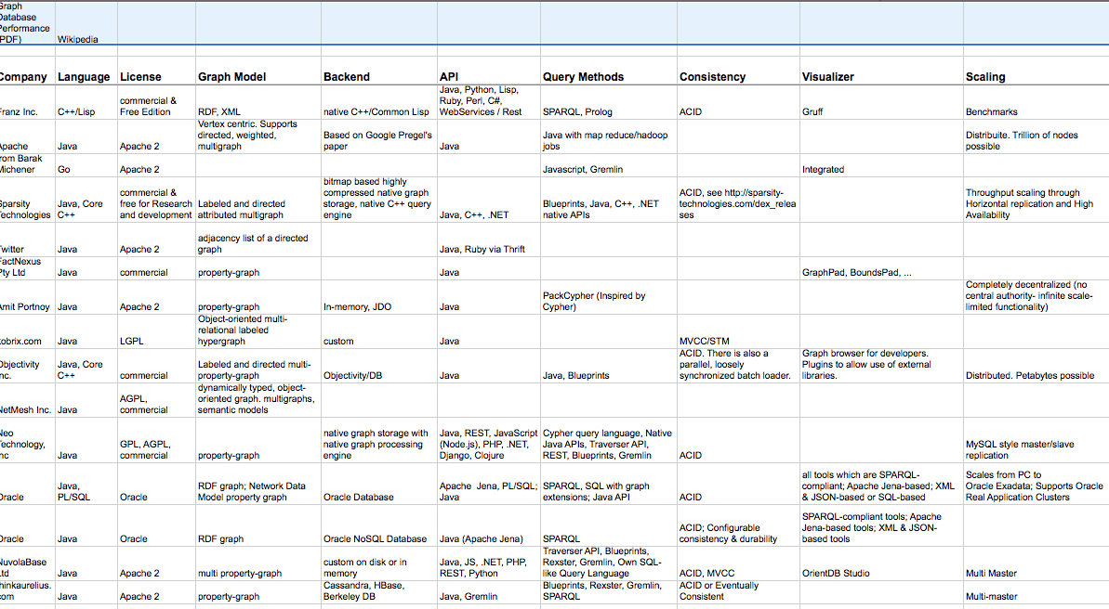
Graph Database Comparison

Slide 31
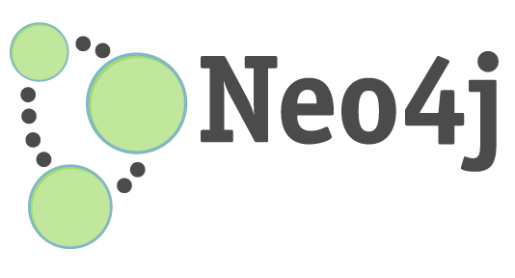
Neo4j
Community and commercial (HA) versions.
Written in Java, support various other languages: Ruby, Python, Scala, etc.
Server with REST API or embedded versions.
Transactional ACID.

Slide 32
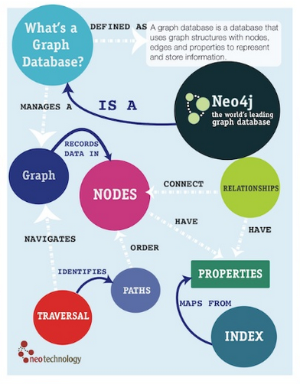
From: http://www.slideshare.net/jexp/intro-to-cypher
Notes:
From: http://www.slideshare.net/jexp/intro-to-cypher

Slide 33
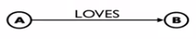

Cypher
Cypher is a declarative graph query language, which focuses on what to retrieve from a graph, not on how to retrieve it.
Cypher syntax looks like ASCII art pattern.
CREATE (A)-[: LOVES]->(B)
Notes:
From: http://docs.neo4j.org/chunked/stable/cypher-introduction.html#_introduction

